Slide 1
Leaf Vein Extraction Based on Gray-scale Morphology
Xiaodong Zheng, Xiaojie Wang, 2010

Slide 2
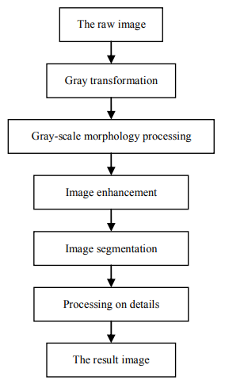
Method
Top hat
Bot hat
Otsu
Opening / Closing

Slide 3
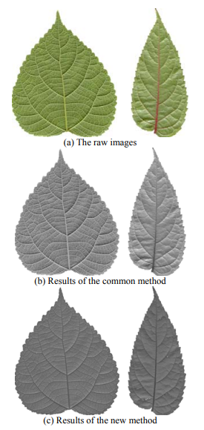
1. Gray transformation
In RGB color space:
Y = 0.299R + 0.587G + 0.114B
In HSV color space:
Y = (((H+90) % 360) / 90 + 1 – V) / 2
Notes:
-> Bỏ saturation -> bỏ độ đậm đà

Slide 4
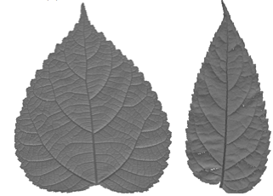
2. Morphological transform
Problem: gray overlap in the whole leaf vein
and the whole background

Slide 5
2. Morphological transform
Erosion operation -> Reduce brightness
Dilation operation -> Enhance brightness
Opening operation -> Elimate the little brightness regions
Closing operation -> Elimate the little darker regions
Top-hat transformation -> Extract the little brighter region
Bot-hat transformation -> Extract the little darker regions

Slide 6
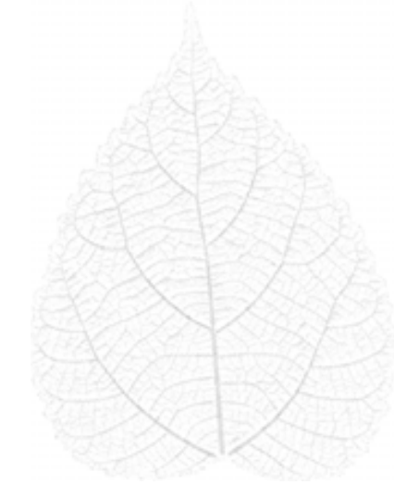
2. Morphological transform
$$g=\left(f∘b−f\right)−(f−f∘b)$$

Slide 7
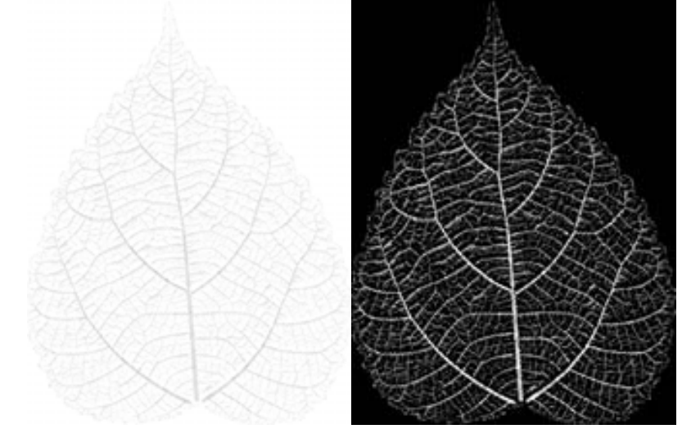

3. Image enhancement: linear intensity
$$g\left(x,y\right)=255∗\frac{g\left(x,y\right)−\min{v}}{maxv−minv}$$

Slide 8
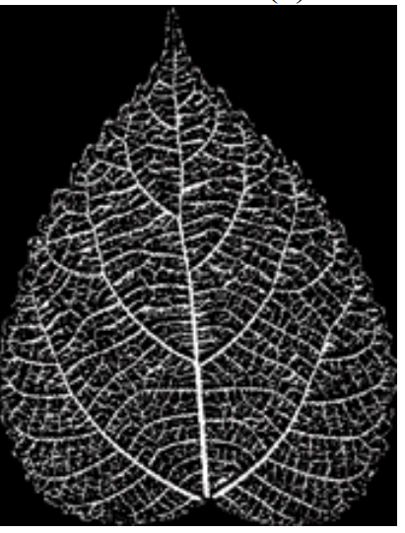
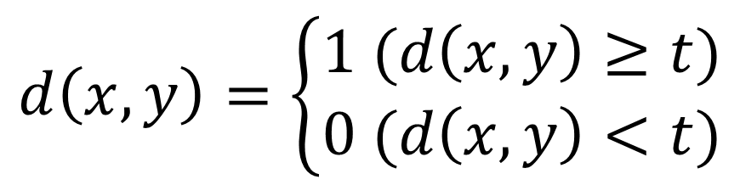
4. Image Segmentation - binarize
$$d\left(x,y\right)=\left\{\begin{aligned}1 (d\left(x,y\right)≥t) \\ 0 (d\left(x,y\right)<t)\end{aligned}\right.$$
t is the threshold calculated by Otsu method
Problem: isolated points and discontinuous lines

Slide 9
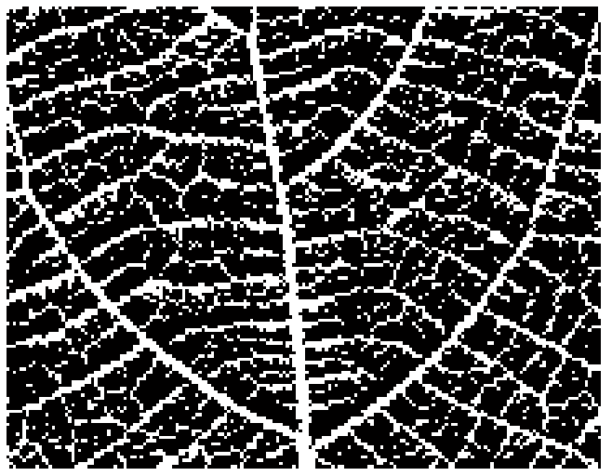
5. Processing on details

Slide 10
5. Processing on details
Linking the discontinuous lines: for each black pixel, count the number of white pixels around in its neighborhood - n. If n < specificed number -> Ignore it.
Eliminating the isolated points: opening operation

Slide 11
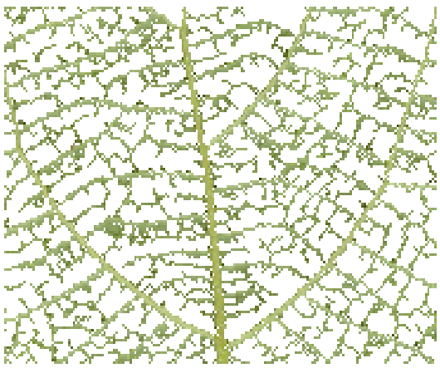
5. Processing on details

Slide 12
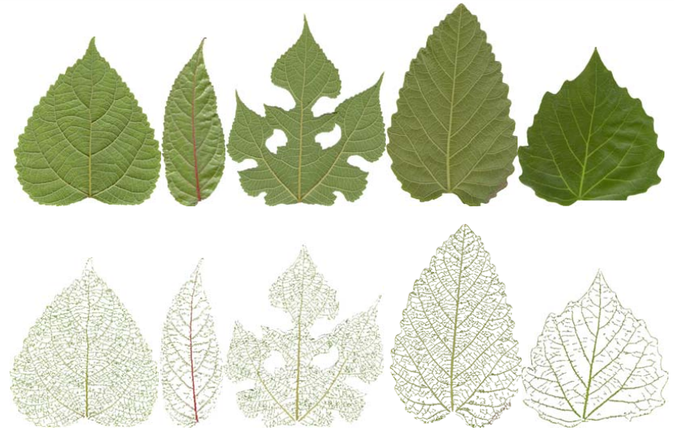

Slide 13
Comments
The method can just find the parts of leaf vein which can be detected with eyes.

